Slide 1

ABP Community Talks 2023.4
https://community.abp.io

Slide 2
What are coming with ABP v7.3 RC.1
Planned Release Date: June 06, 2023 (TODAY!)

Slide 3

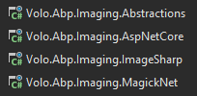
ABP Framework: Imaging
Services for resizing and compressing images
Imagesharp and MagickNet providers
ASP.NET Core action filter integration

Slide 4
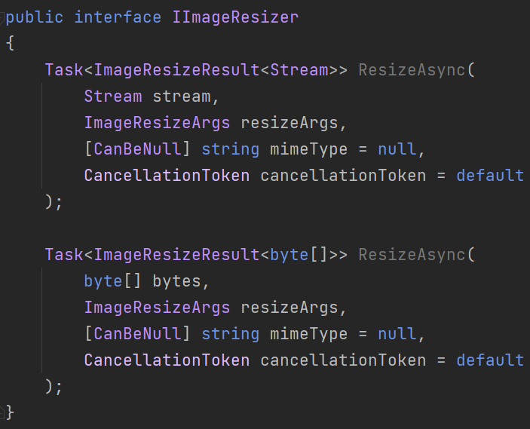
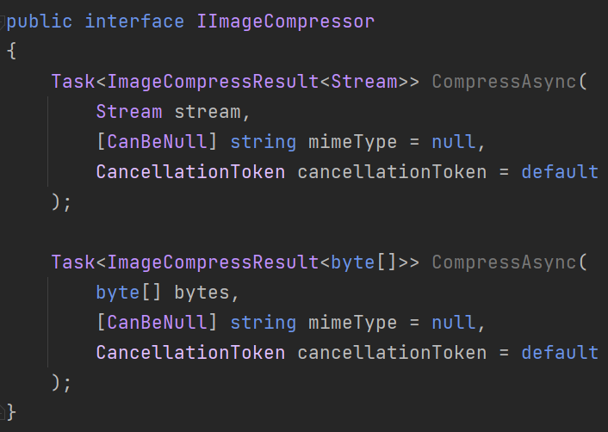
Imaging: Services (Abstractions)

Slide 5
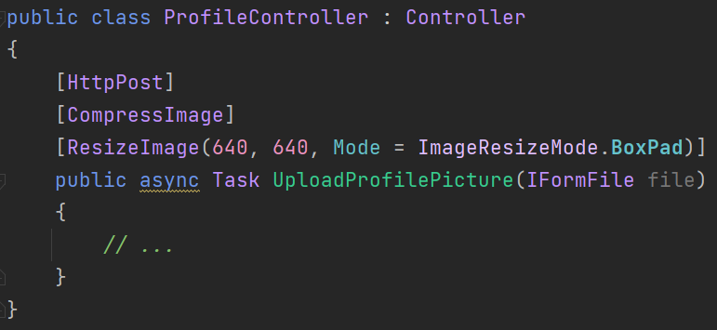
Imaging: ASP.NET Core Action Filters

Slide 6
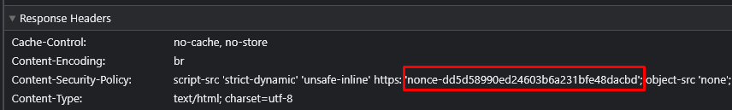
Script Nonce
Explicitly allow the scripts to be executed in your application.
Disallow all others to prevent XSS attacks.
Add a nonce value to Content-Security-Policy header:
Add nonce attribute (with the same value) to all script tags:

Slide 7
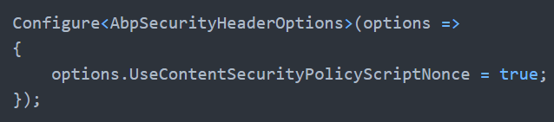

Script Nonce
Enable UseContentSecurityPolicyScriptNonce option:
Add the Security Headers middleware to your request pipeline:

Slide 8
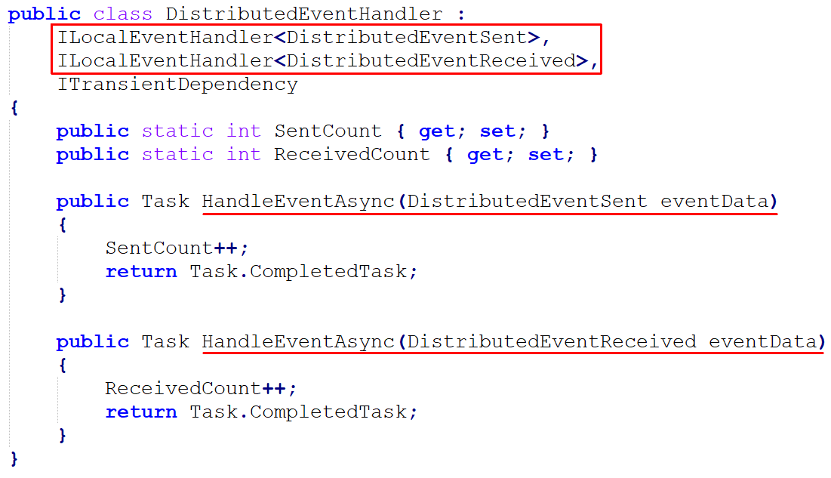
Listening to Distributed Events

Slide 9
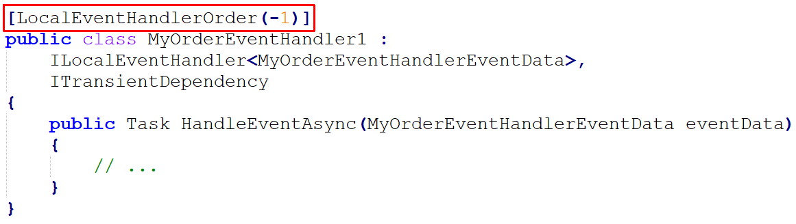
LocalEventHandlerOrder Attribute
Content

Slide 10
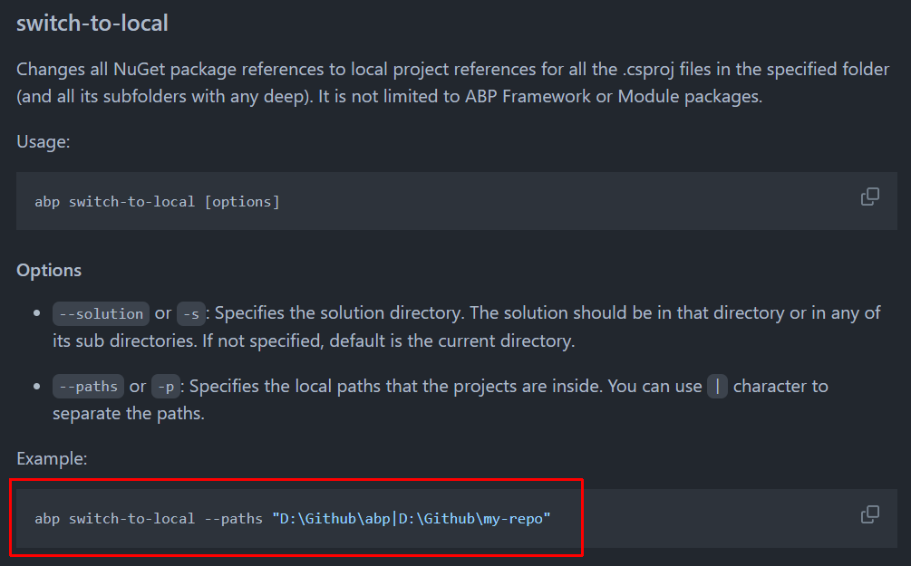
ABP CLI: switch-to-local

Slide 11
ABP Commercial News

Slide 12
The ABP Studio
An ABP-integrated desktop application for ABP developers.
Planned release date: Q3 of 2023.
Initial Features:
Create new solutions & modules
Install/uninstall modules
Explore your solution and used modules in a high-level view
Build monolith-modular and microservice solution structures easier
Run multi-application / microservice solutions easily
Kubernetes-integrated development environment

Slide 13
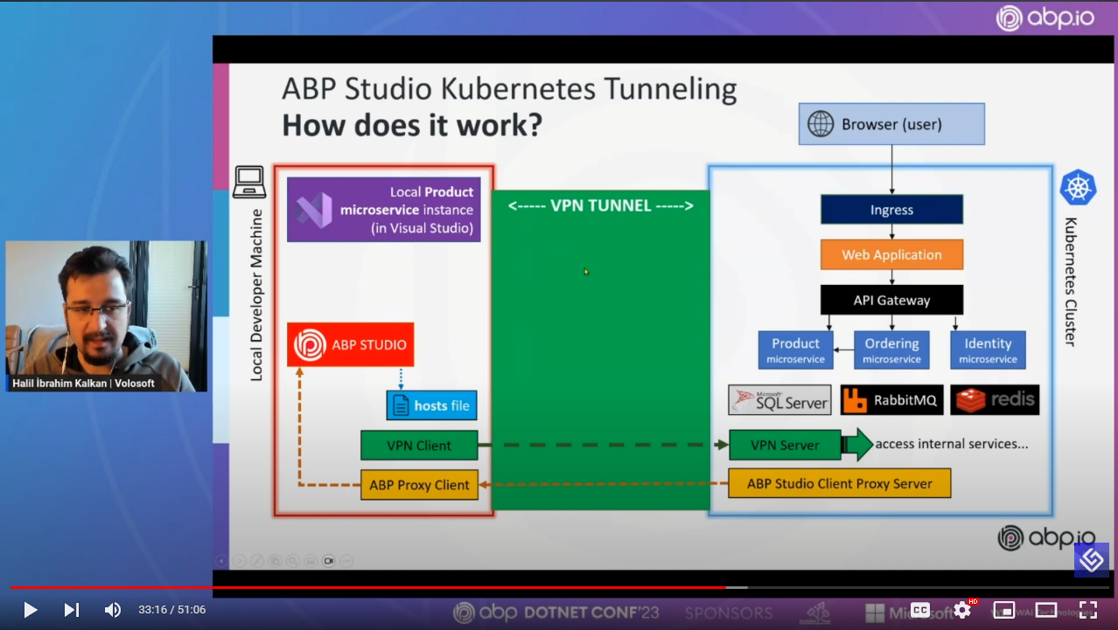
Kubernetes Integrated Microservice Development with ABP Studio
https://abp.io/talks/kube-dev

Slide 14
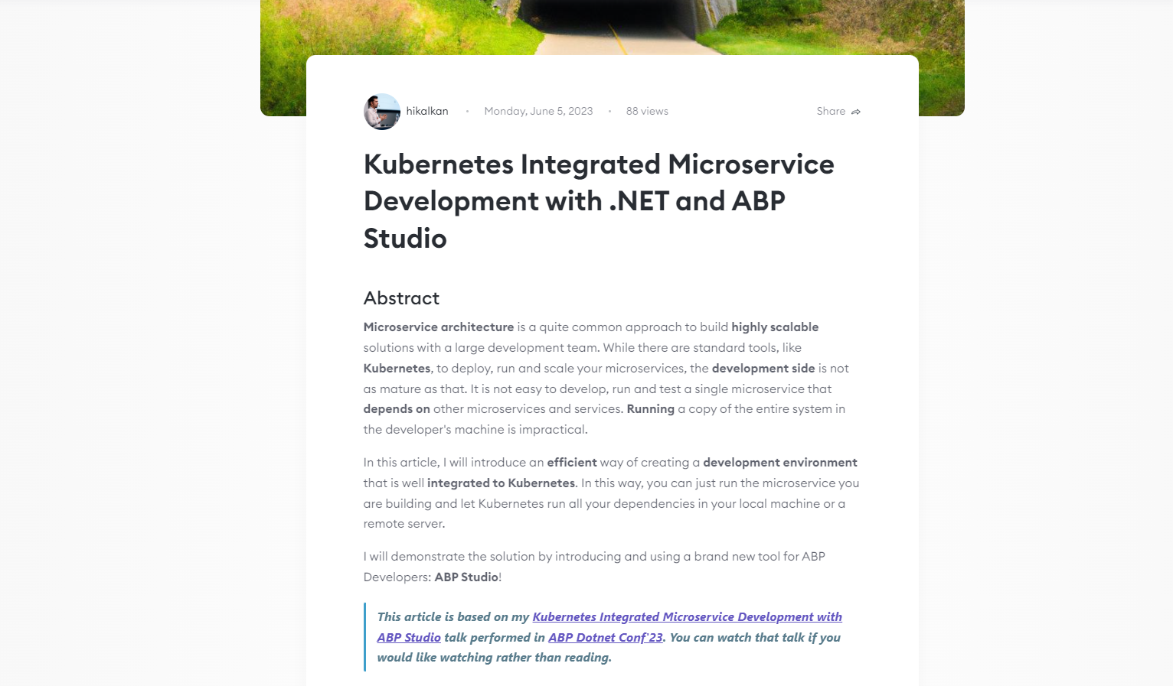
https://community.abp.io/

Slide 15
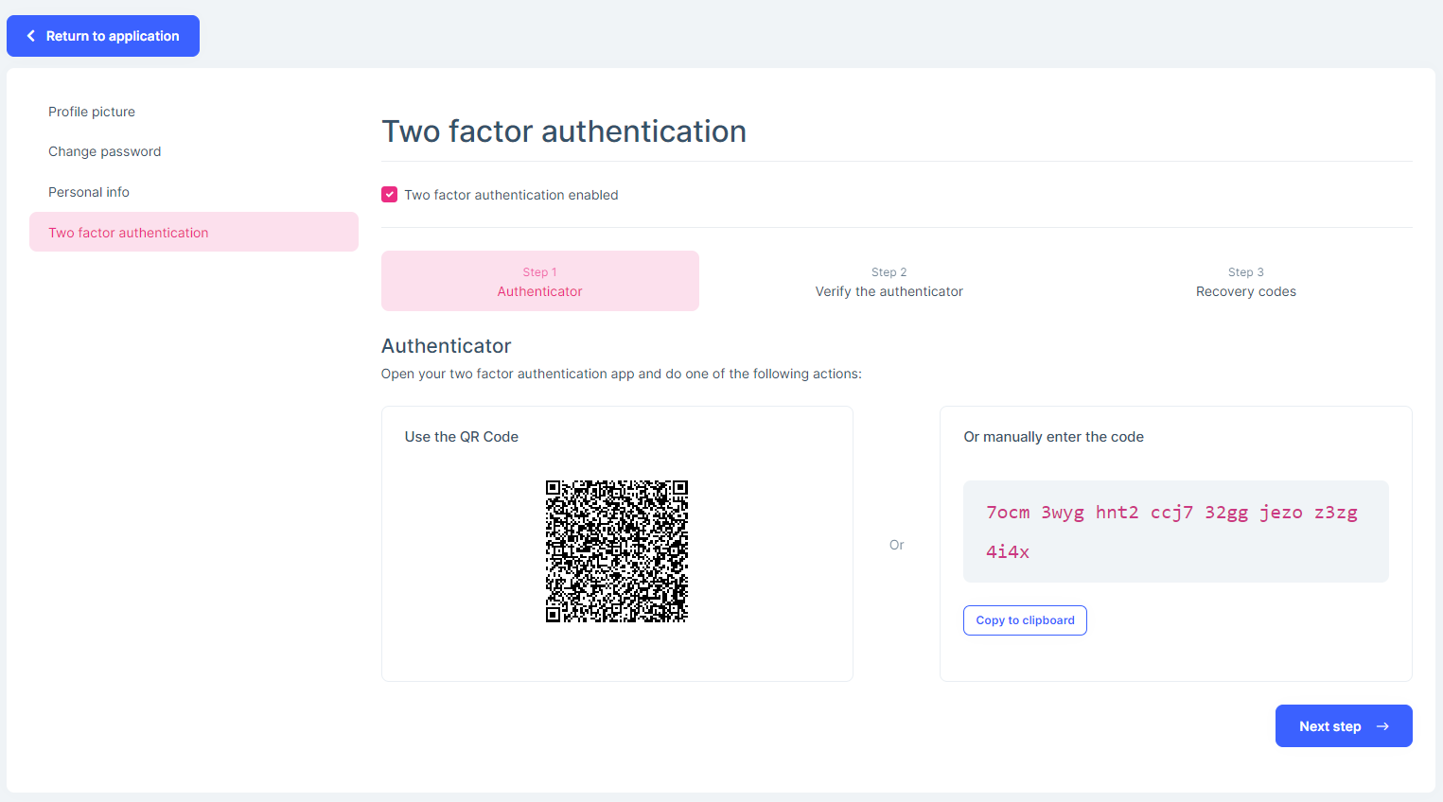
Two Factor Authenticator

Slide 16
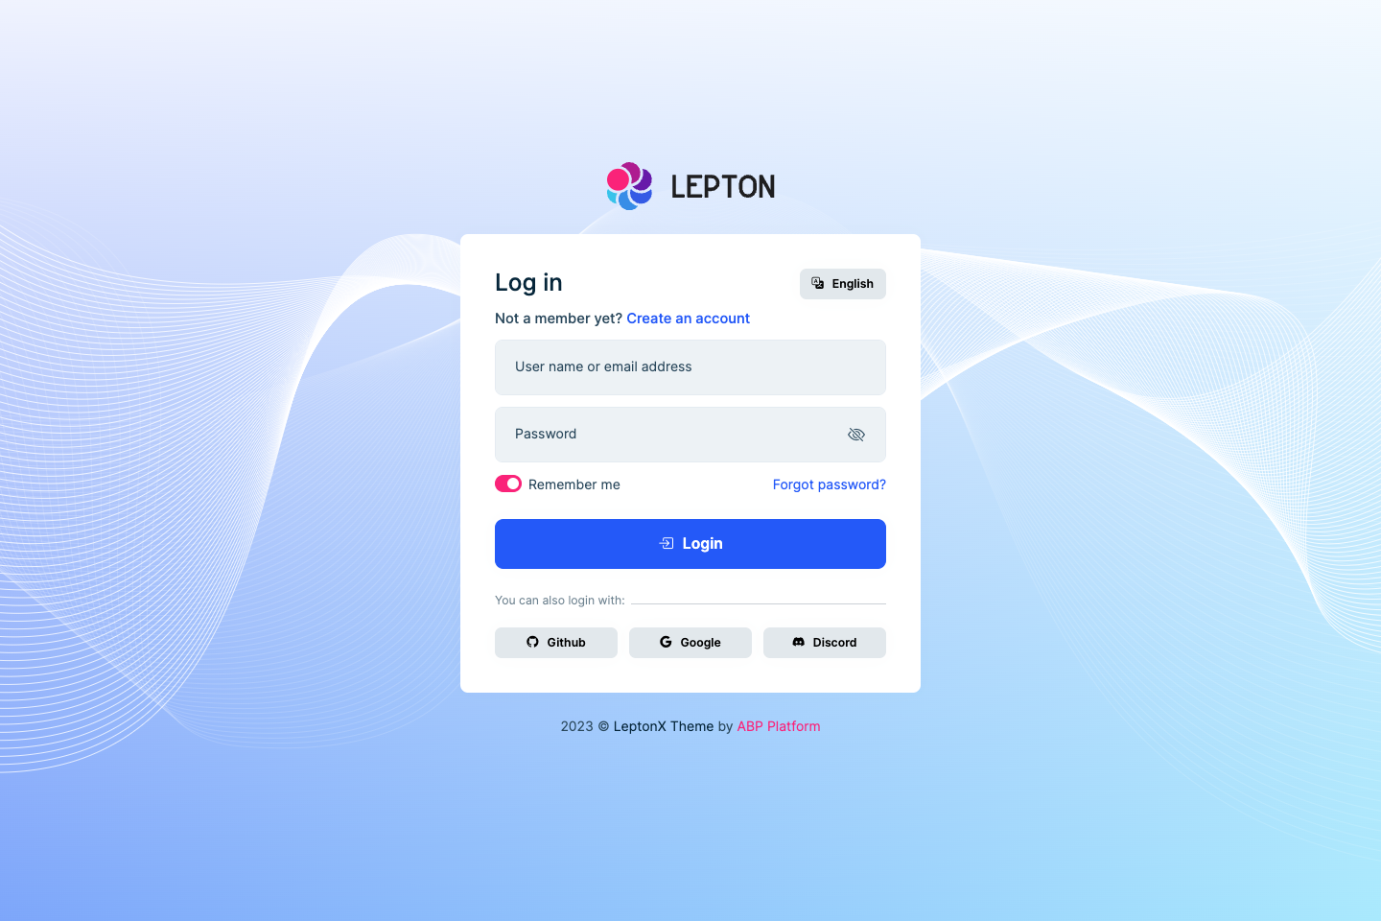
LeptonX: The New Login Page (Light)

Slide 17
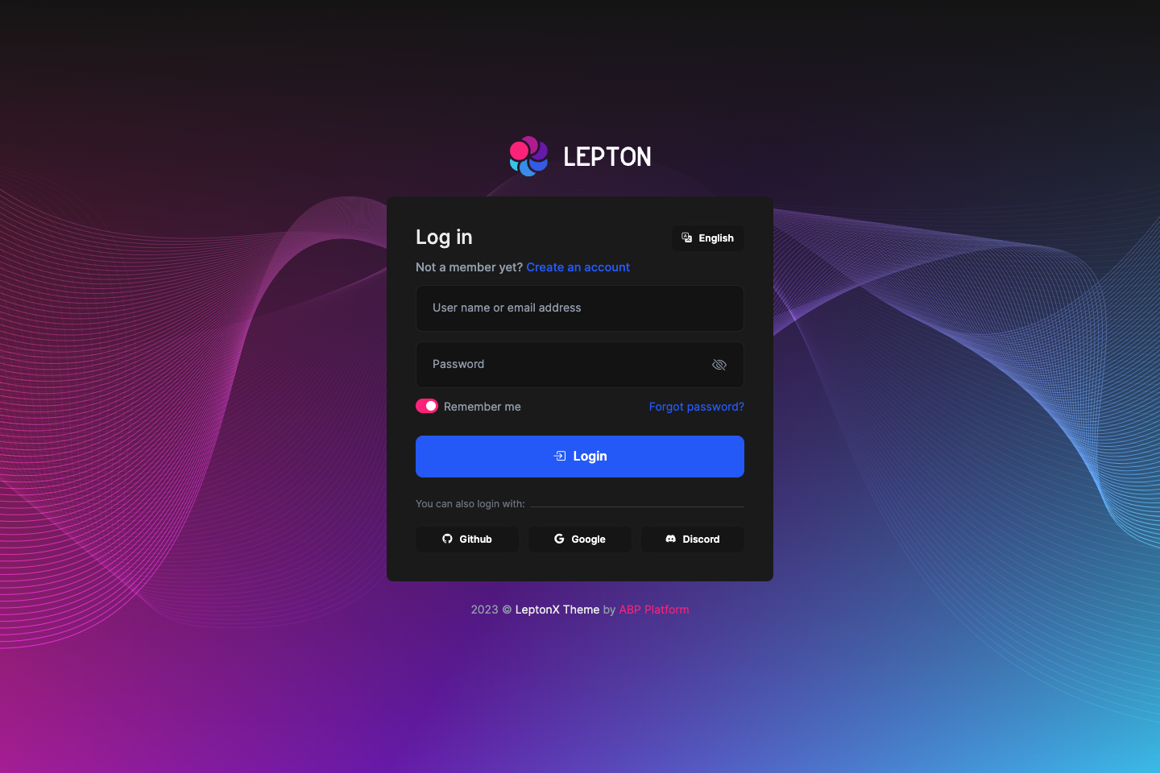
LeptonX: The New Login Page (Dark)

Slide 18
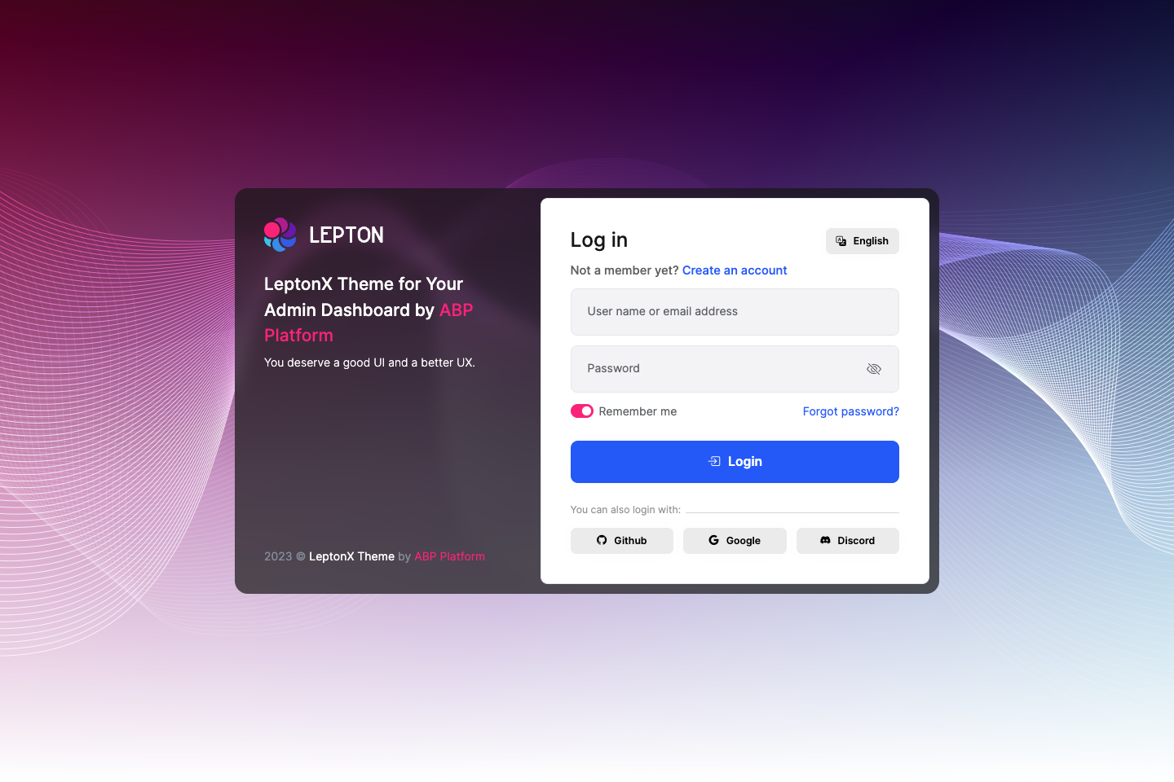
LeptonX: The New Login Page (Alternative)

